Slide 1
Beyond Excel
Automating Clinical Project Management with Interactive R Shiny Dashboards
Emily Murphy, Melanie Hullings

Slide 2
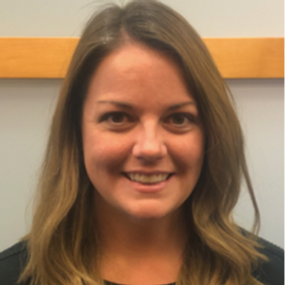
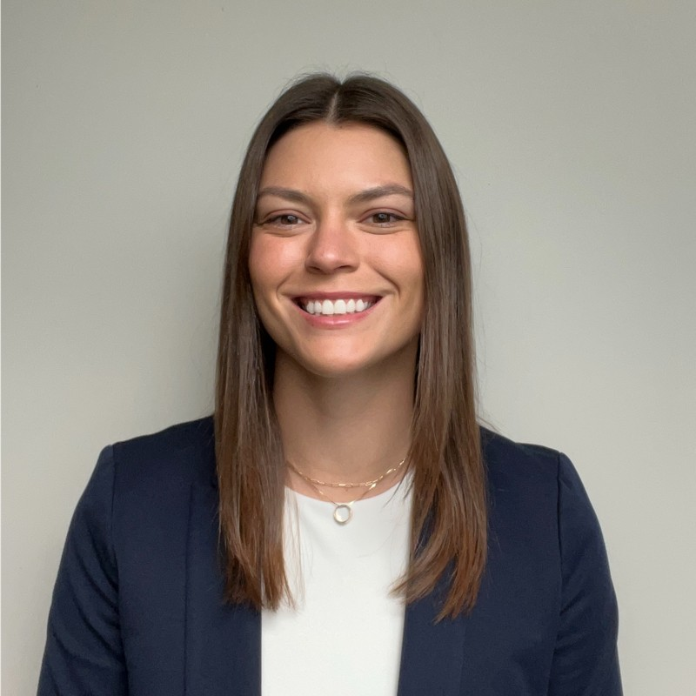
Melanie Hullings
Director, Clinical Data Analytics & Programming
Emily Murphy
Senior Clinical Data Analyst, Statistics, Formation Bio
Notes:
[Mel] Hi I’m Mel Hullings, Director of Clinical Data Analytics & Programming at Formation Bio, a tech-enabled drug development company. My prior experience was primarily in implementing bioinformatics solutions at clinical research sites to optimize clinical data quality and the clinical trial experience. I lead a team of clinical data scientists using Posit and other tools to unlock real-time data insights for our clinical trial and drug development teams. And this is my team member Emily.
[Emily] Hi I’m Emily… Emily Murphy is an accomplished Sr. Statistical Data Analyst who champions the mission of data-driven clinical decision making at Formation Bio. Emily combines her background in traditional pharma at Pfizer with her experience in tech to drive the company’s growth and innovation. At Formation Bio, Emily is using R-based solutions to optimize critical aspects of clinical drug development, enabling more efficient trial design, faster trial completion, and higher quality trial data.

Slide 3



Imagine you are the captain of a clinical trial…
Notes:
[Emily]
Imagine you are the captain of a clinical trial soaring through the air when all of a sudden

Slide 4


…when the check engine light comes on
Protocol Deviation
Notes:
[Emily]
The check engine light comes on. In this case we are talking about protocol deviations. A protocol deviation is a critical type of error in a clinical trial that occurs when a patient critically deviates from the intended plan for treatment outlined in the protocol. One protocol deviation may not be the end of the world but patterns of PDs can lead to …. EXPLAIN
Now imagine as the captain the panic going through you when this warning light comes on. You are flying a very expensive, very complicated, clinical trial through the air. Your passengers, the sites and patients, are counting on you to make sure their flight goes smoothly.
You need to do something about this protocol deviation and FAST. You need to figure out how big of a deal it is and how we can prevent any future issues ASAP!
How would you go about making a critical decision about the direction of the trial quickly?

Slide 5
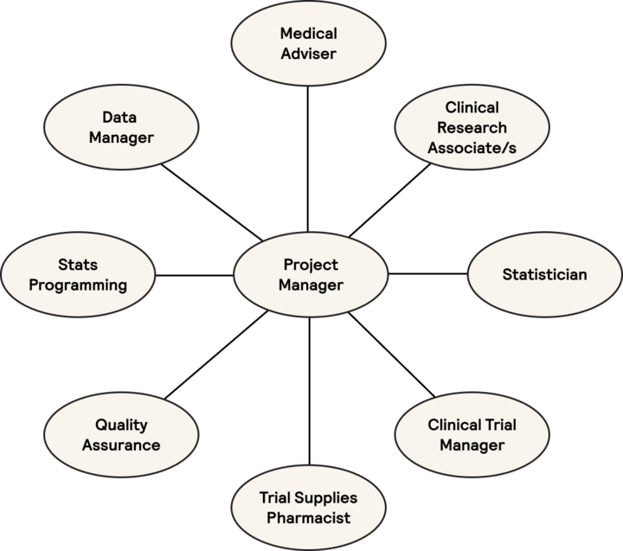

The Clinical Trial Journey
Clinical Project Managers (CPMs) are the captain of the trial journey
Highly cross-functional role
Requires quick but rigorous decision-making
Real-time data insights are needed for complex decision-making and frequent course correction
Notes:
[Mel]
As captains of the clinical trial journey, Clinical Project Managers play a critical role in a clinical trial. They are in charge of maintaining study timelines, identifying any risks to those throughout the trial, and coming up with risk mitigation strategies to get the trial back on track. They spend a lot of time before a clinical trial begins projecting out timelines for the trial and making sure all the moving pieces fit together across all of these teams involved across data management, medical, site operations, stats, and study drug management. Risks could include anything that could impact timelines, patient safety, product quality, or data integrity. That’s a really wide scope and it requires having all the information to keep a pulse on all of these cross-functional teams as the trial progresses. One aspect of this information that will anchor our talk today is Protocol Deviations. Deviations are a small part of the big picture but are the most critical metric for indicating quality of the subject, site, and data, indicative of risk that CPMs need to monitor on multiples levels, and are important to everyone on the trial to recognize and mitigate. PDs represent one particular risk that CPMs are interested in. PDs, like all other risks, need to be identified as early as possible in order to prevent further issues. So when issues pop up, CPMs need to have this data to make fast and rigorous decisions that affect the course of the whole trial.

Slide 6



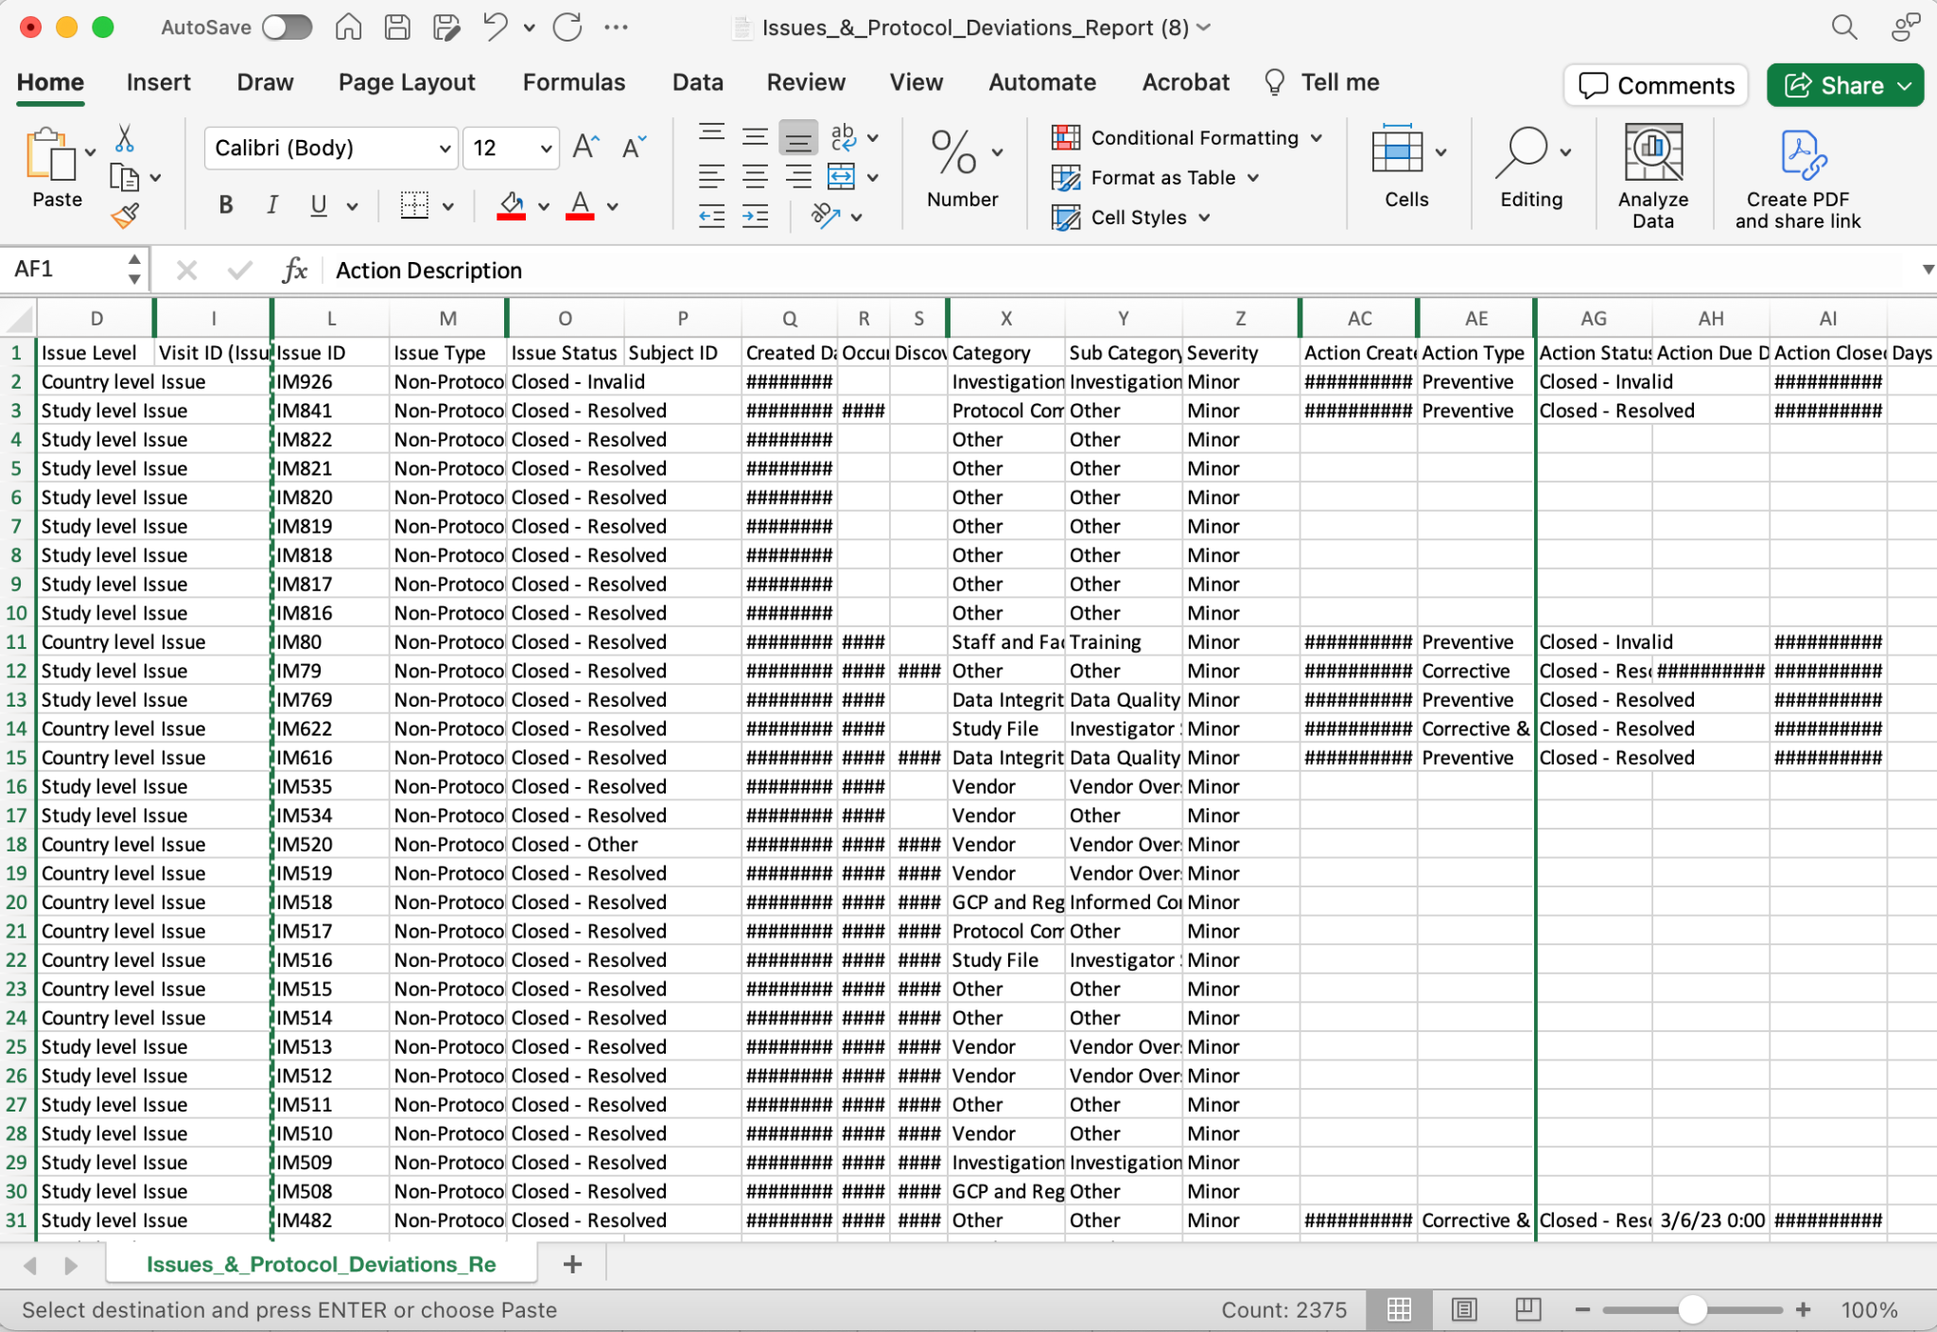

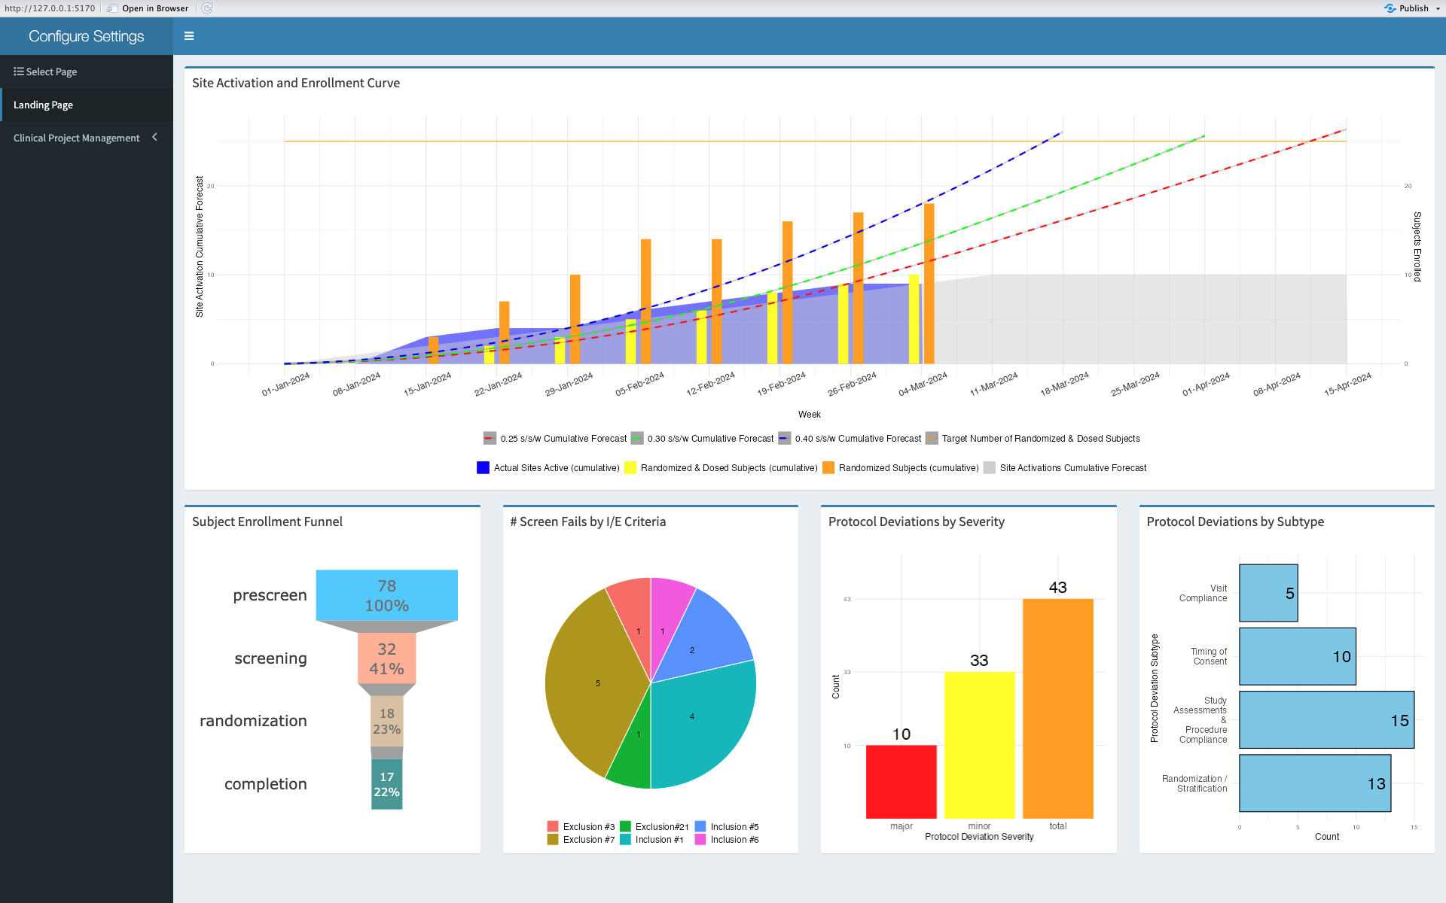
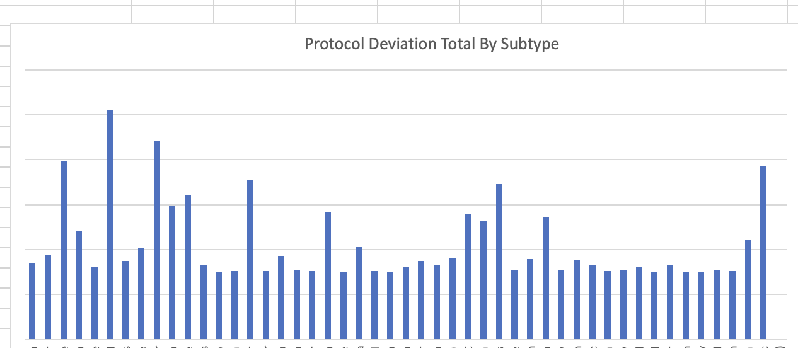

Race against the clock to make high impact clinical decisions quickly
5+ Steps
1 Click
VS
Notes:
[Emily]
In the case of protocol deviations that come up in the course of a clinical trial, usually digging into the raw data is needed to identify the issue, identify the root cause, and begin to identify any trends or remediations that need to be put in place to fix this issue. Industry standard methods to complete this type of data analysis typically consist of many manual steps.
First you would downloading the raw data straight from the EDC. next you would open it in excel and joining any data sets needed there (using vlookup?). Maybe you would filter or do some more advanced data cleaning. Then you would create a pivot table. You’re thinking - am I looking at the most recent data? Am I looking at the right columns in the source code? Am I doing this right? WAit a second… didn’t we have an urgent decision we needed to make QUICKLY
What if instead the metrics you needed to look at were immediately available at the click of a button. As the captain of the clinical trial, you would be able to seamlessly and easily make data driven decisions about your clinical trial without wasting your precious time manually manipulating data in excel
That’s exactly what we have built usings RShiny - a dashboard that is home to critical trial metrics that study team members can leverage to make data driven decisions quickly.
Throughout the course of this talk we are going to show you how we did this

Slide 7



Clinical Data Analytics & Programming (CDAP)
Team of data scientists, clinical data analysts, and systems developers
Improve speed and accuracy of clinical insights
Collaborate closely with clinical study team members to provide reporting
Notes:
[Mel]
The Clinical Data Analytics & Programming CDAP) team is composed primarily of R programmers with varied backgrounds in clinical trial and data management, academic data science, and pharma who collaborate closely with clinical stakeholders to identify areas of investment in the drug development process that would benefit from technology and automation primarily for reports and dashboards as well as clinical data analysis and data science. Usually, this type of analytics team would be silo-ed, more of a service desk, or even contracted out, but we benefit from the ability to embed ourselves on the clinical study team to form a deep understanding of the problem space and identity tech solutions that are very fit for purpose. We have the advantage of working very closely with cross-functional teams, witnessing some of the pain points first hand, and working with the stakeholders to clearly define their user requirements. As seasoned programmers we saw the pain points that came from the repeated manual data manipulations as an opportunity for R Shiny to help enable data-driven clinical decisions. Our team is committed to decreasing the amount of manual data manipulation performed by clinical trial teams in order to increase the speed and accuracy of clinical insights, monitoring, and trial execution.

Slide 8

Flying Blind: Manual processes make monitoring data difficult
Industry standard data analysis procedures are manual and time intensive
Results in loss of insight into trends in metrics and issue management activities at a study level
Overall can have a major impact on data quality and trial success
Notes:
[Mel]
What we found was that CPMs often felt like there were flying blind and had to revert to manual data processing. Especially with the many different data captures systems involved in clinical trials now such as the EDC, often multiple other vendor systems, and CTMS, it sometimes seems easiest to download all these local files and dig into the data in Excel. But while Excel is a valuable tool, it is often not the most efficient way to perform repeated analysis and data visualization. These reports are often stored locally with different study team members looking at different version of the dataset or are embedded in meeting meetings. This kind of workflow often leads to duplicative work and loss if insight into trends in metrics and issue management and a study level.

Slide 9

Air Disaster: Real time metrics can increase trial oversight
Without real-time metrics, the study team often discovers issues too late and has to be reactive as impact is felt
Real-time metrics allows the study team to proactively prevent issues and optimize cost, speed, and quality in areas such as:
Resourcing
Timelines
Protocol deviations (PDs)
Notes:
[Mel]
To prevent an air disaster, real-time metrics represent a valuable tool for effective risk mitigation. Without real-time metrics, the study team often discovers issues too late and have to be reactive. Real-time metrics allow the CPMs to proactively preventing issues from propagating. This enables the study team to implement better mitigation strategies sooner, prevent issues, and improve overall quality. To bring it back to our protocol deviation example, when protocol deviations are discovered early, they can often be mitigated through methods such as retraining patients, sites, and study team members. Real-time metrics also allow CPMs to optimize resourcing and adjust as needed to meet or exceed timelines. To do this effectively, the most current, accurate, and consistent data needed to make decisions must be readily accessible to guide the journey.

Slide 10
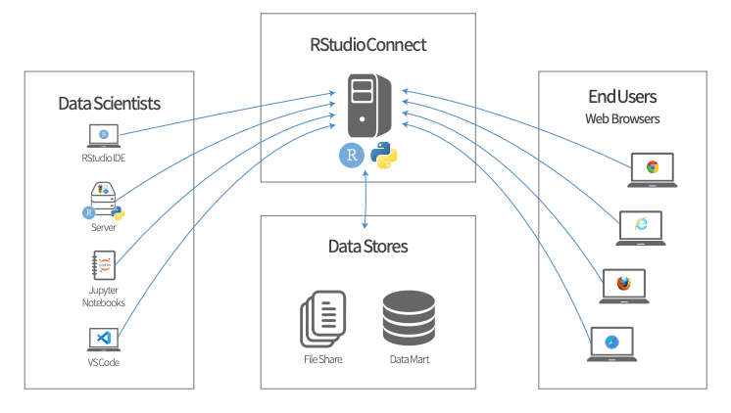
R Shiny Dashboard Solution
Highly customizable and interactive web applications for robust data visualization
Bridge the gap between statistical expertise and user-friendly interface design
Enables agile and informed decision-making in clinical trial management
Notes:
[Emily]
Our solution is made possible by implementation of a posit reporting suite including posit connect, workbench, and package manager. R shiny is an emerging piece of technology in the clinical analytics space that is gaining popularity and adoption in industry.
The CDAP team we represent is trained in biostatistics and bioinformatics and was already familiar with the R programming language making adoption of R Shiny a natural progression
….. You already have a team like this internally? ……
The power of R Shiny comes from its ability to create highly customizable and interactive web applications for clinical trial data visualization. It’s a ideal tool as is bridges the gap between our analytics team with deep statistical expertise and a non-technical clinical operations team through the user-friendly interface design. So statistical power + easy to use design allows us to create sophisticated data visualisations and to present this in a comprehensive and actionable format for CPMs.
As Formation Bio continues its trajectory as a tech-enabled pharmaceutical entity, R Shiny's versatility and integration within the CDAP team's skill set solidify its position as a strategic asset, enabling agile and informed decision-making in clinical trial management.

Slide 11
Clinical trial data journey
DATA SOURCES
DATA ACQUISITION
DATA AGGREGATION
R SHINY REPORTING
CTMS
EDC
Refreshing Live
Posit Workbench
ePRO
Lab
Data Warehouse
Imaging
Posit Connect
Wearables
IRT
Notes:
Mel

Slide 12
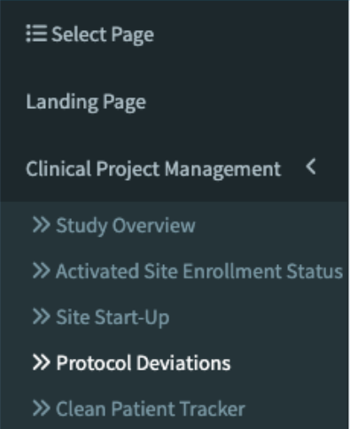
Notes:
[Emily]
Now let’s take a look at this dashboard. With an R Shiny application this would exist as a web page that study team members can bookmark and self-service whenever they want.
The landing page has some examples of key metrics that our CPMs are interested in keeping an eye on day to day in a trial. This is a high level overview of the trial. On the left hand side navigation bar we see tabs representing more of a deep dive into different areas of interest for a CPM.
At the top we have a site activation and subject enrollment curve. Here, CPMs track projected numbers against real numbers to be able to track whether we are behind or ahead of scheduled activation and enrollment numbers.
Here we see that actual enrollment happened faster than projected so CPMs likely worked to coordinate IP stocks and data monitoring earlier in the trial than anticipated
We also have a pie chart of the inclusion/exclusion breakdown for all of the screen fails in this trial. Here we see that there are a lot of exclusion #7 and Inclusion #1. This might prompt a CPM to interrogate prescreen methods or even trigger a protocol amendment?
We already have some high value use cases for a real-time metrics dashboard.
The last section in the bottom right is focused on protocol deviations.

Slide 13
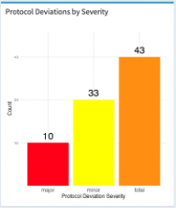

~25% of PDs are majors
Notes:
[Emily]
Here a CPM notices a new issue - there are 10 major PDs which is making up about 25% of all PDs. Major PDs are the most serious category of PD and are the ones that could really have a negative impact on the success of a trial if we are not careful.

Slide 14
Investigate further
Notes:
[Emily]
The CPM knows there’s something up with PDs and now needs to investigate further. The CPM would then navigate to additional tabs on the left hand side to the tab called “protocol deviations” where more granular and interactive dashboards exists to enable CPMs to dig in and find the root cause behind the high number of major protocol deviations

Slide 15
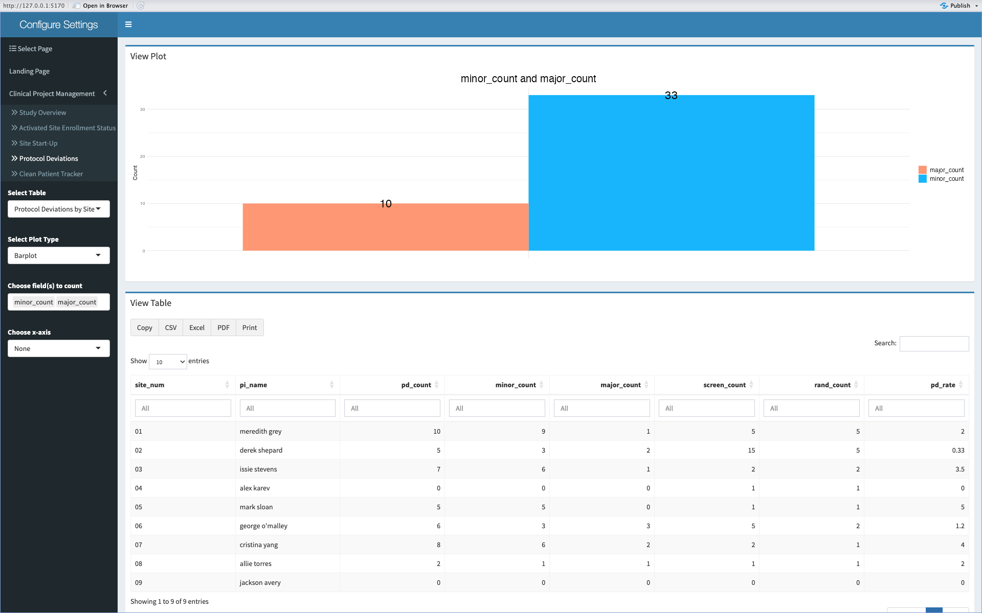
Notes:
[Emily]
In the protocol deviation tab we have a very flexible and interactive dashboard that CPMs can use to find the root cause. This type of interaction would usually be in pivot tables in excel that require a lot of manual manipulation before getting to insights. But in the Rshiny dashboard, that is available at the click of a button.
At the top we have a graph that will update based on user input and some select raw data at the bottom of the page. This table at the bottom is pre-populated with fields of interest that a CPM commonly would use to diagnose issues.
We have the site information, total PD count, major vs minor information, enrollment numbers, and a pre-calculated rate column.
So we see right now the graph is defaulting to simply show the breakdown of major and minor PDs but can add any of these fields to the above visualization

Slide 16
Visualize PDs
by Site
Notes:
[Emily]
A common place to start the investigation is to look for a particular problematic site to be able to answer if this is a systemic or site specific problem.
To do so, the CPM would slice the graph above by site by clicking the drop down here and selecting site

Slide 17
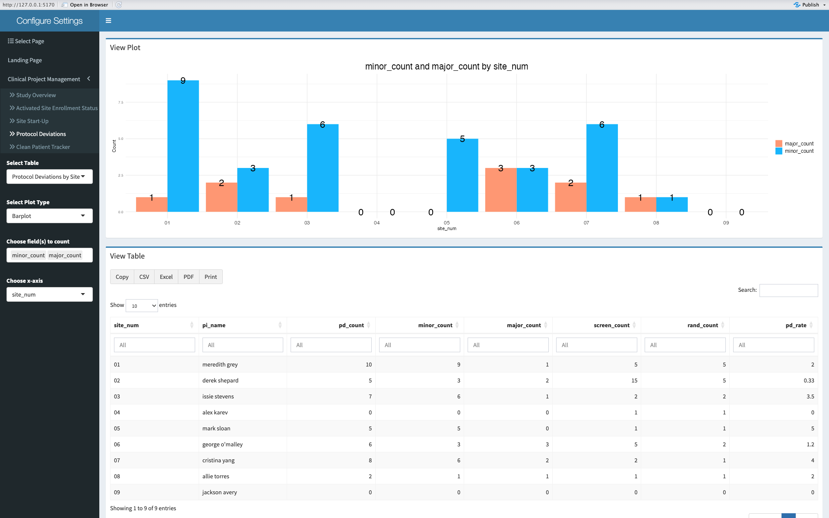
Notes:
[Emily]
Now we have added site number to the x-axis of the graph and are able to visualize the breakdown of major and minor PDs at each site

Slide 18
Identify site with highest % of majors
Notes:
[Emily]
From this we notice that site 6 looks possibly problematic. This site has the highest % of major PDs - half of the PDs at this site are majors

Slide 19
Insight
Site 06 has highest % of major PDs
Action
Retrain site 06 to prevent future issues
Notes:
[Emily]
At a glance a CPM can make the call to initiate retraining of site 6 in order to prevent any additional PDs at this site. What could have been a larger problem and a continued trend was identified early and risk mitigations were put in place before it was too late.

Slide 20
Navigating with Data: Real-time metrics unlock data-driven decision making
R Shiny’s built-in interactivity reduces a CPM’s time-to-decision and drives:
Improved efficiency and accuracy
Empowered CPM teams to shift their focus towards strategy
Democratized data access
Reduced burden on CPMs
“ I am now able to explore the data I need without any help from the CDAP team to quickly make a decision in real-time during a meeting instead of spending at least an hour finding and digging into data”
Notes:
[Mel]
The CPM team has now been using the Study Dashboard to drive team meetings and investigate data issues and findings. They are able to quickly find all the information they need in one place which has improved the efficiency and accuracy of data analysis. This then translates into the ability to quickly make real-time, data-driven decisions and act on insights. This has helped to foster a culture of data democratization and data-driven decision making on our studies. By empowering a CPM to explore the data independently, this has given them the tools they need to come to a data-driven decision faster and more efficiently leading to higher quality data for analysis, but also to a faster trial.
DEWORD
QUOTE FROM CPM about time saved/adoption
R Shiny’s built-in interactivity reduces a CPM’s time-to-decision and drives:
Improved efficiency and accuracy of repeated reporting tasks
Empowered CPM teams to shift their focus towards more strategic decision-making, in-depth interpretation of trial insights, and proactive resourcing
Democratized data access through self-service aspect of the R Shiny application
Reduced the burden on CPMs to be solely responsible for sharing trial metrics

Slide 21

The Great Beyond: What’s Next?
Since demonstrating Study Dashboard’s criticality for efficient trial operations we will:
Continue to work closely with CPM and other teams to add more features
Build Study Dashboards tailored to specific study needs during study start up for each trial
Track data quality impact as our north star in an “air traffic control” dashboard
Notes:
[Mel]
Since demonstrating that the Study Dashboard is critical for efficient trial operations, the dashboard development is incorporated into study startup timelines for all trials at Formation Bio. We are continuing to work closely with CPMs to add new features to this app such as study startup data as we had originally focused on trial execution, work with other study team members such as Medical and Safety to develop other Shiny app dashboards, and we are also working within the CDAP team to track the impact that our work has on overall data quality as our north star in an “air traffic control” dashboard. We’re really excited for how powerful Posit dashboards can be when customized in the way to empower teams and automate processes.
Our goal is to empower not just the captain, but everyone on the clinical trial journey,
CDAP are the air traffic controllers for all trials

Slide 22
Questions?

Slide 23
Thank You
Melanie Hullings (melanie@formation.bio)
Emily Murphy (emurphy@formation.bio)

